Slide 1
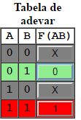
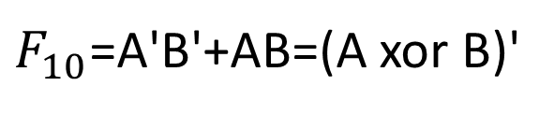
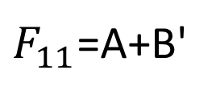
Diagrame V-K
ce contin stari NU CONTEAZA
$F_{10}$=A'B'+AB=(A xor B)'
 | B | B' | B
A
A' |  | 1 | 0
A |  | 0 | 1
$F_{11}$=A+B'
 | B | B' | B
A
A' |  | 1 | 0
A |  | 1 | 1

Slide 2
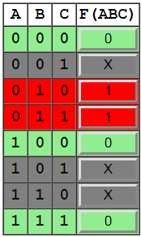
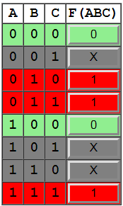
Sa se minimizeze
Fie functiile:
F(ABC)₀₀₀=A'B
 | AB | 00 | 01 | 11 | 10
C
0 |  | 0 | 1 | X | 0
1 |  | X | 1 | 0 | X
F(ABC)₁₁₁=B+C
 | AB | 00 | 01 | 11 | 10
C
0 |  | 0 | 1 | X | 0
1 |  | X | 1 | 1 | X
Notes:
Y=!AB
Y=B

Slide 3
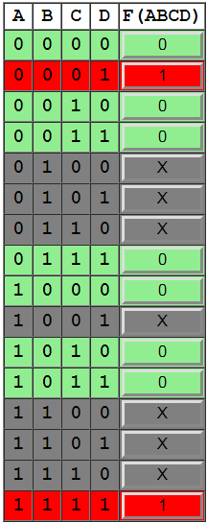
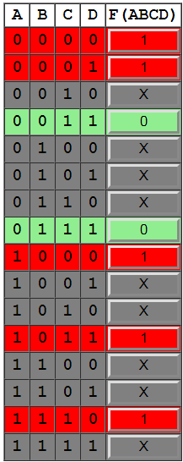
Sa se minimizeze
Fie functiile:
 | CD | 00 | 01 | 11 | 10
AB
00 |  | 0 | 1 | 0 | 0
01 |  | X | X | 0 | X
11 |  | X | X | 1 | X
10 |  | 0 | X | 0 | 0
Notes:
Y=AB+!CD
Y=A+!C+!D

